Slide 1

MySQL- Product Inventory & Billing System
Presented by:
Ms. Sanskruti Raut

Slide 2
Problem Statement
Small to mid-sized businesses often struggle with managing their product inventories, supplier details, customer records, and billing processes efficiently due to the lack of an integrated and automated system. Manual tracking leads to errors, stock outs, overstocking, and poor customer service, ultimately affecting profitability and operational efficiency.
The Product Inventory & Billing System project aims to develop a robust, SQL-based relational database solution to streamline the end-to-end inventory and billing workflow.
This system provides capabilities for:-
Managing product categories, stock levels, reorder thresholds, and pricing details.
Associating suppliers with products to ensure consistent supply chain management.
Capturing and maintaining customer information for billing and service history.
Recording and analyzing sales transactions to support decision-making.
Executing complex queries and generating real-time reports for business insights.

Slide 3
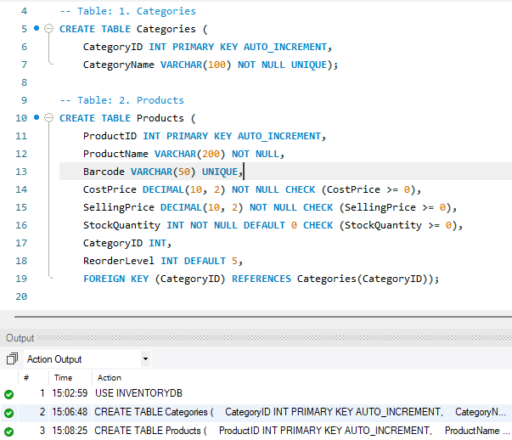
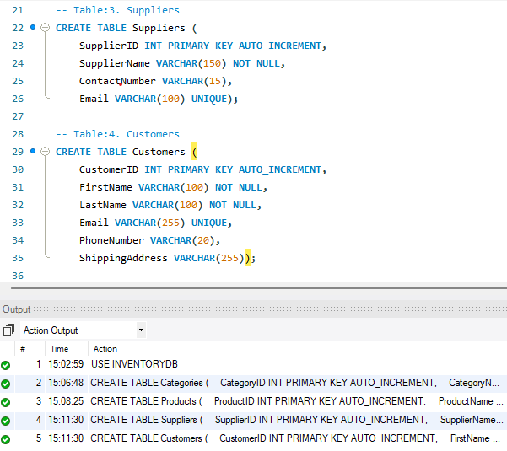
Entity Identification
Observation: SQL CREATE TABLE statements that define the structure of two tables: Categories (with Category ID as primary key and Category Name) and Products (with Product ID as primary key, and columns like Product Name, Barcode, Cost Price, Selling Price, Stock Quantity, Category ID, and Reorder Level, including constraints and a foreign key referencing the Categories table).
Observation: SQL query for creating the Suppliers and Customers tables, defining their columns, data types, and constraints.

Slide 4
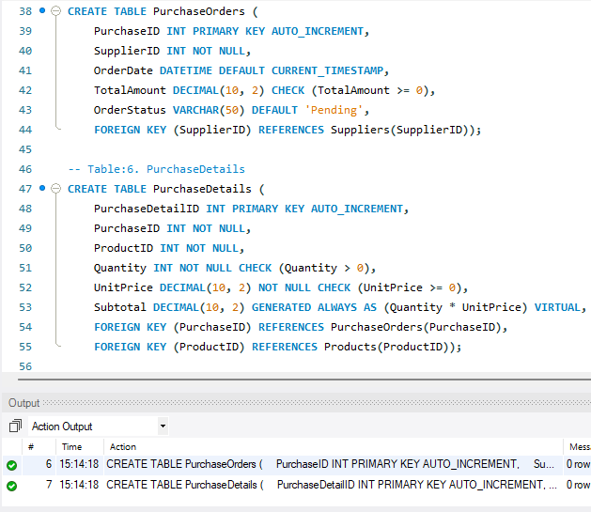
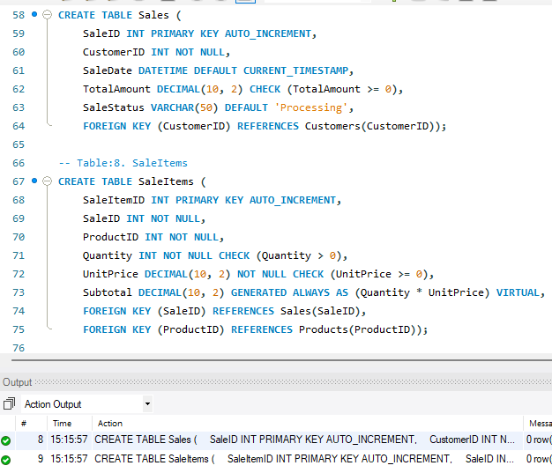
Entity Identification
Observation: SQL query for creating the Purchase Orders and Purchase Details tables, defining their structure with columns, data types, constraints, and foreign key relationships.
Observation: SQL query for creating the Sales and Sale Items tables, including their columns, data types, constraints, and foreign key relationships.

Slide 5
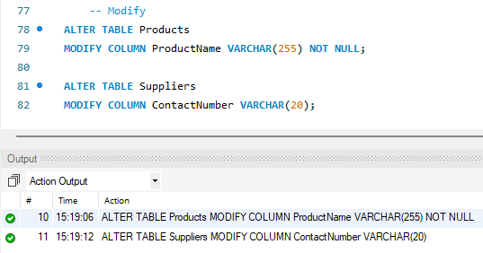
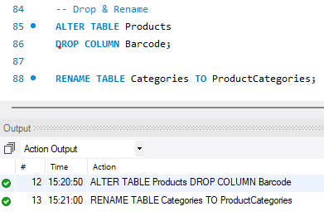
Entity Identification
Observation: SQL query that modify the Products table by dropping the Barcode column and renaming the Categories table to Product Categories
Observation: SQL query that modify the Products table by changing the Product Name column to VARCHAR(255) and setting it as NOT NULL, and modifies the Suppliers table by changing the Contact Number column to VARCHAR(20)

Slide 6
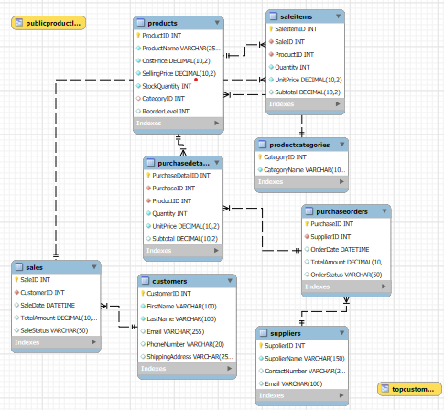
ER Diagram
Observation: The ER diagram illustrates a comprehensive database design for a retail business, encompassing core entities like customers, products, and suppliers, alongside transactional entities such as sales and purchase orders, all interconnected to facilitate efficient tracking of sales, inventory, and procurement.

Slide 7
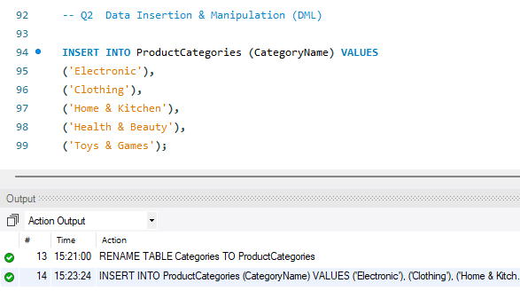
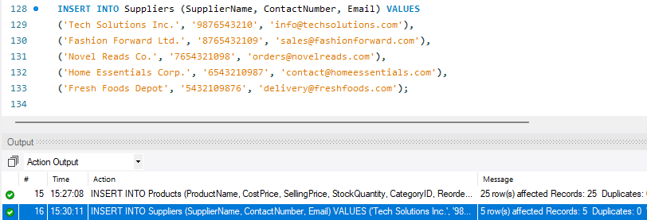
Data Insertion and Manipulation (DML)
Observation: SQL INSERT query that add rows into the Product Categories table, specifying the Category Name for each new category: 'Electronic', 'Clothing', 'Home & Kitchen', 'Health & Beauty', and 'Toys & Games'.
Observation: SQL INSERT query that add data into the Suppliers table, including Supplier Name, Contact Number, and Email for each supplier.

Slide 8
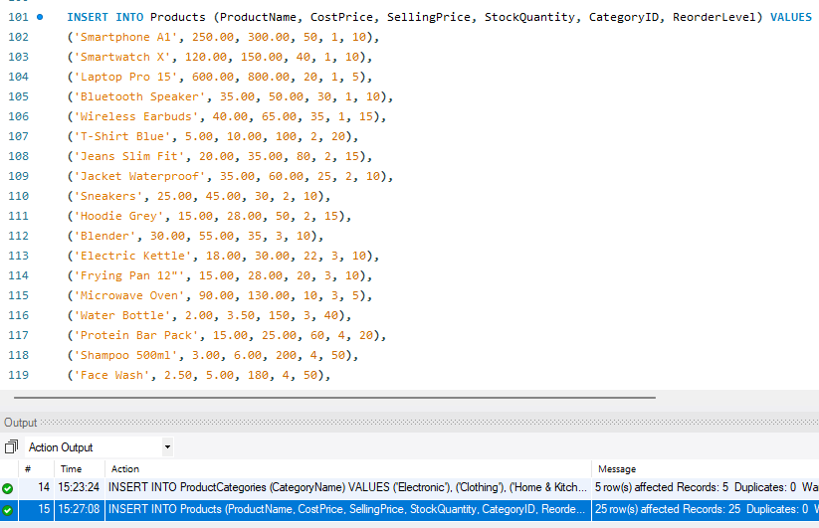
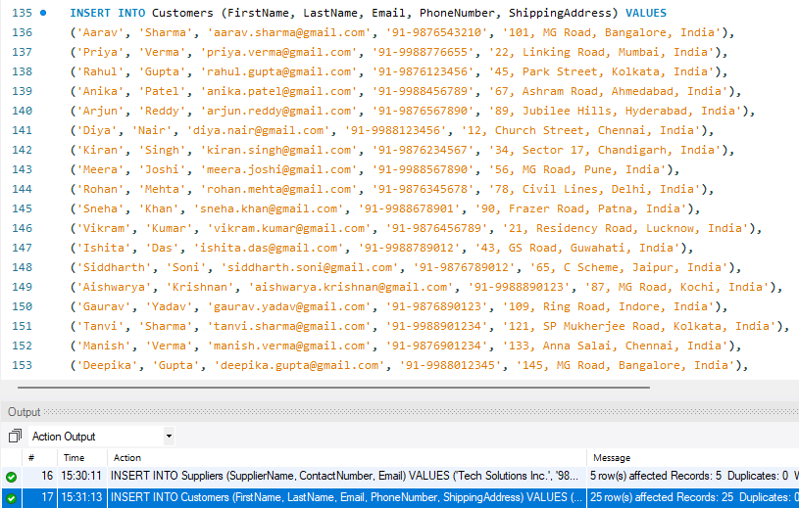
Data Insertion and Manipulation (DML)
Observation: SQL INSERT query that add multiple rows of data into the Products table, including Product Name, Cost Price, Selling Price, Stock Quantity, Category ID, and Reorder Level for each product.
Observation:SQL INSERT query that add multiple rows of data into the Customers table, including customer details like First Name, Last Name, Email, Phone Number, and Shipping Address.

Slide 9
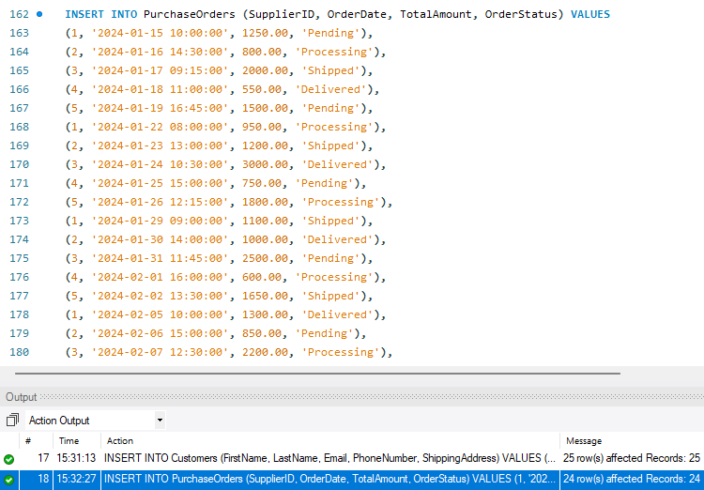
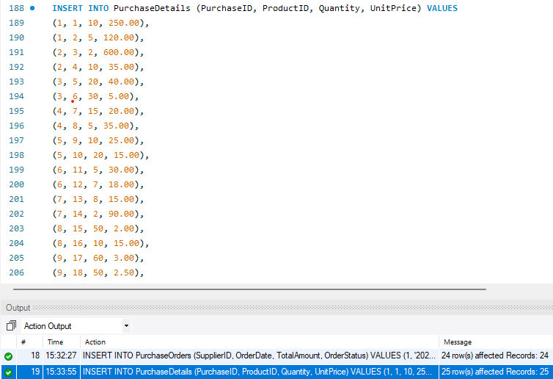
Data Insertion and Manipulation (DML)
Observation: The image shows SQL INSERT query that add data into the Purchase Orders table, including Supplier ID, Order Date, Total Amount, and Order Status for each purchase order.
Observation: The image shows SQL INSERT query that add data into the Purchase Details table, specifying the Purchase ID, Product ID, Quantity, and Unit Price for each item included in various purchases.

Slide 10
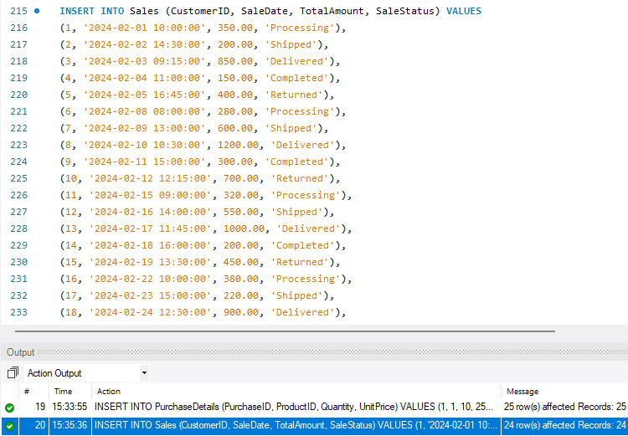
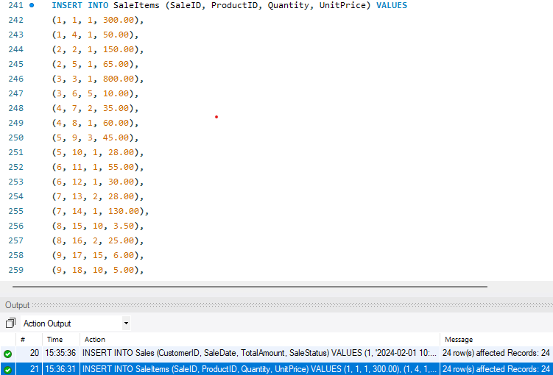
Data Insertion and Manipulation (DML)
Observation: The image shows SQL INSERT statements that add data into the Sale Items table, specifying the Sale ID, Product ID, Quantity, and Unit Price for each item in various sales transactions.
Observation: The image shows SQL INSERT statements that add multiple rows of data into the Sales table, including Customer ID, Sale Date, Total Amount, and Sale Status for each sale

Slide 11
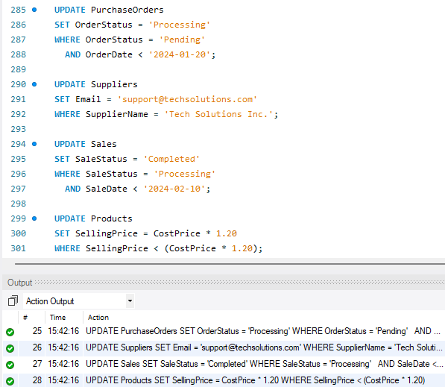
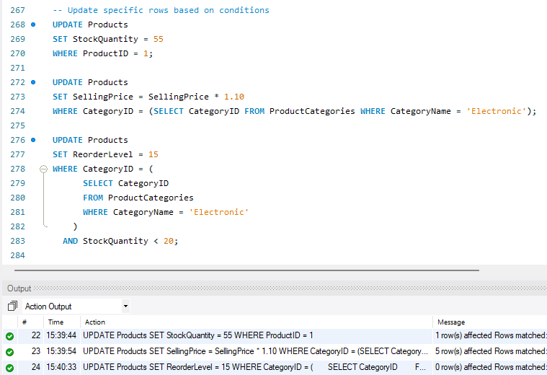
Data Insertion and Manipulation (DML)
Update
Observation:SQL UPDATE query that modify the Products table: the first updates the Stock Quantity for Product ID 1, the second increases the Selling Price of 'Electronic' category products by 10%, and the third sets the Reorder Level to 15 for 'Electronic' products with Stock Quantity less than 20.
Observation: SQL UPDATE query that modify data in four tables: Purchase Orders (changing Order Status), Suppliers (updating Email), Sales (setting Sale Status), and Products (adjusting Selling Price), along with the output indicating the number of affected rows for each update.

Slide 12
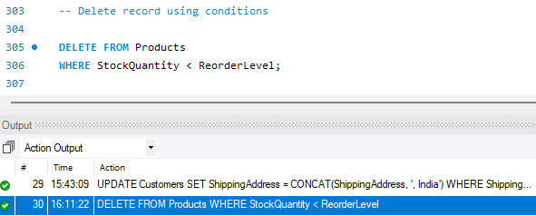
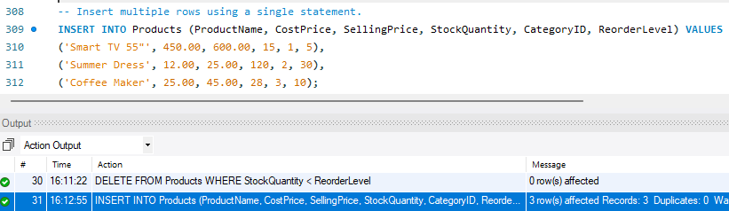
Data Insertion and Manipulation (DML)
Delete
Observation: SQL DELETE query that removes records from the Products table where the Stock Quantity is less than the Reorder Level.
Insert
Observation: SQL INSERT query that adds three new products ("Smart TV 55", "Summer Dress", and "Coffee Maker") into the Products table with their respective details.

Slide 13
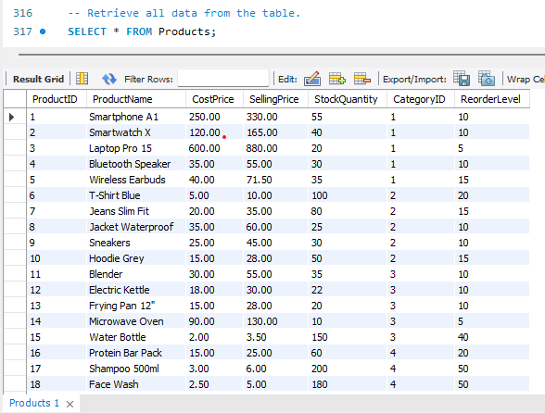
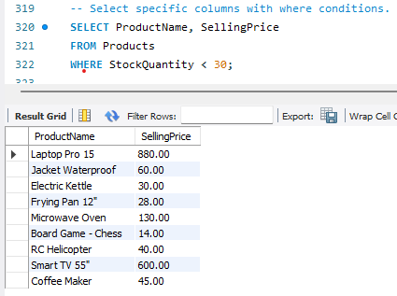
SELECT Queries & Filtering
Select
Where Condition
Observation: SQL query using SELECT * to retrieve all columns and rows from the Products table, displaying product details such as Product ID, Product Name, Cost Price, Selling Price, Stock Quantity, Category ID, and Reorder Level
Observation: SQL query that selects the Product Name and Selling Price from the Products table for products with a Stock Quantity less than 30.

Slide 14
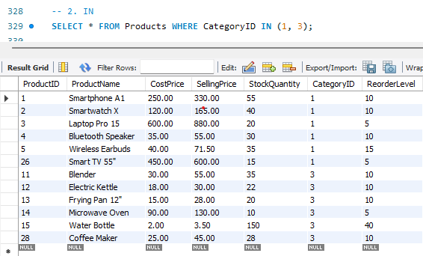
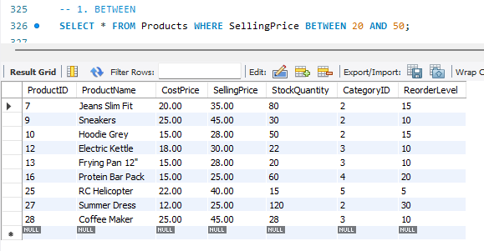
SELECT Queries & Filtering
Between
In
Observation: SQL query using the BETWEEN operator to select products with a selling price between 20 and 50.
Observation: SQL query using the IN operator to select all columns from the Products table where the Category ID is either 1 or 3.

Slide 15
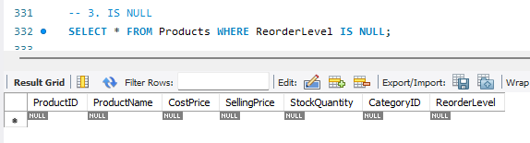
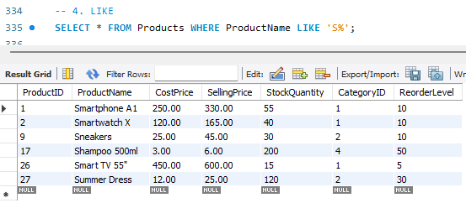
SELECT Queries & Filtering
Is NULL
Observation: SQL query using IS NULL to select records from the Products table where the Reorder Level is null.
Like
Observation:SQL query using the LIKE operator to select products with names that start with the letter 'S'.

Slide 16
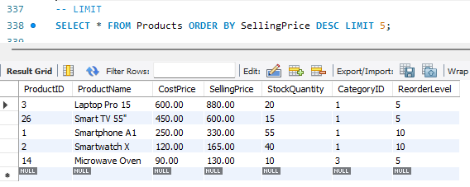
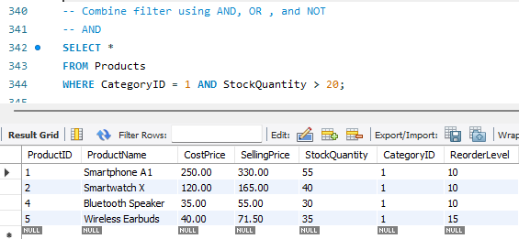
SELECT Queries & Filtering
LIMIT
Observation : The SQL query retrieves the top 5 most expensive products from the Products table, ordered by Selling Price in descending order.
AND
Observation: SQL query using the AND operator to select products that belong to Category ID 1 and have a Stock Quantity greater than 20.

Slide 17
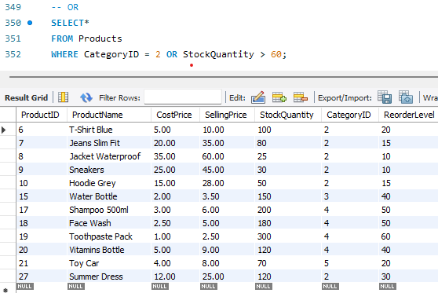
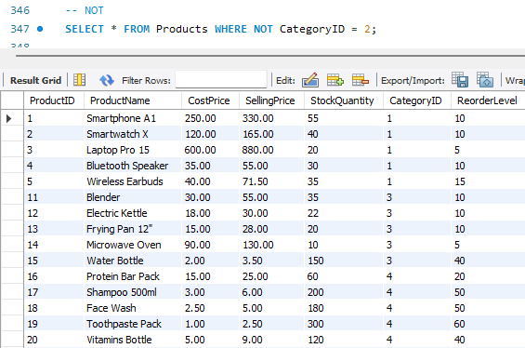
SELECT Queries & Filtering
OR
NOT
Observation: The image shows a SQL query using the OR operator to select all columns from the Products table where the Category ID is 2 or the Stock Quantity is greater than 60.
Observation: The image shows a SQL query using the NOT operator to select all columns from the Products table where the Category ID is not equal to 2.

Slide 18
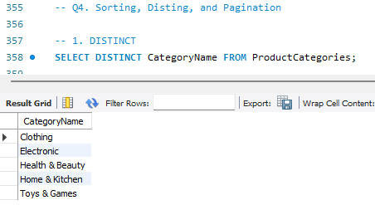
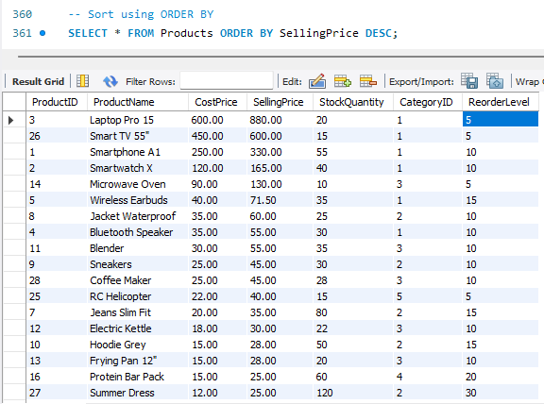
Sorting, Distinct, and Pagination
DISTINCT
ORDER BY
Observation: The image shows a SQL query using the DISTINCT keyword to select and display unique Category Name values from the Product Categories table.
Observation: The image shows a SQL query that sorts all records from the Products table by Selling Price in descending order.

Slide 19
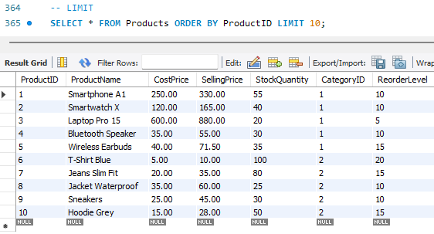
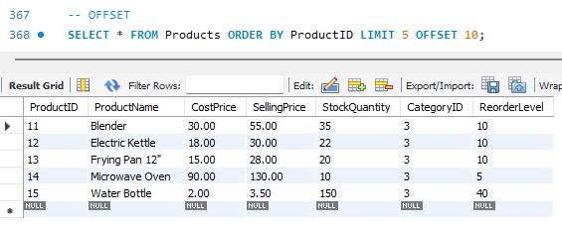
Sorting, Distinct, and Pagination
LIMIT
OFFSET
Observation: The image shows a SQL query using LIMIT and OFFSET to retrieve a specific subset of records (5 records starting from the 11th record) from the Products table, ordered by Product ID.
Observation: The image shows a SQL query using LIMIT to retrieve the first 10 records from the Products table, ordered by Product ID.

Slide 20
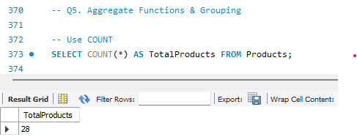
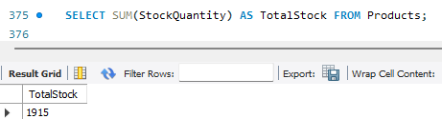
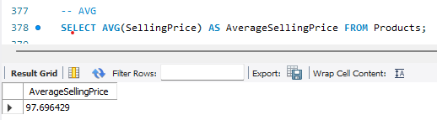
Aggregate Functions & Grouping
COUNT
Observation: The image shows a SQL query using the COUNT(*) function to count all rows in the Products table, returning the total number of products as 28
SUM
Observation: The image shows a SQL query using the SUM() function to calculate the total stock quantity from the Products table, with the result being 1915
AVERAGE
Observation: The image shows a SQL query using the AVG() function to calculate the average selling price from the Products table, resulting in an average of 97.696429.

Slide 21
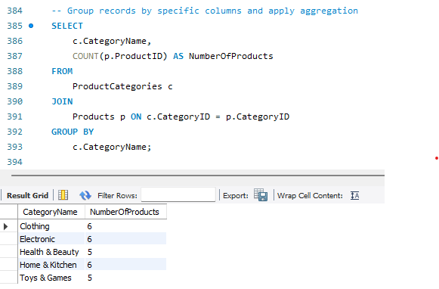
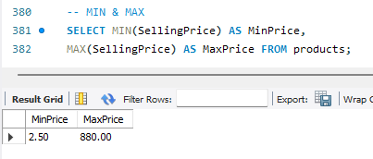
Aggregate Functions & Grouping
MIN & MAX
Observation: The image shows a SQL query using MIN() and MAX() functions to find the minimum and maximum selling prices from the Products table, returning 2.50 as the minimum and 880.00 as the maximum.
Observation: The image shows a SQL query that groups records from the Product Categories and Products tables by Category Name and counts the number of products in each category.

Slide 22
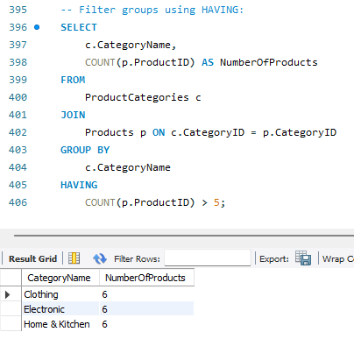
Aggregate Functions & Grouping
HAVING
Observation: SQL query that filters grouped data using the HAVING clause to display category names and their product counts, only for categories with more than 5 products.

Slide 23
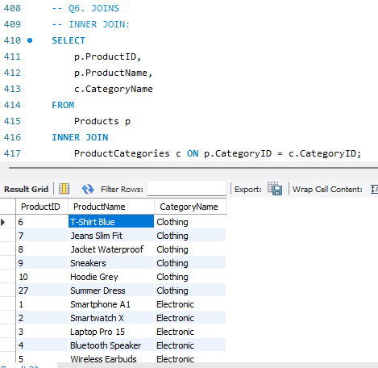
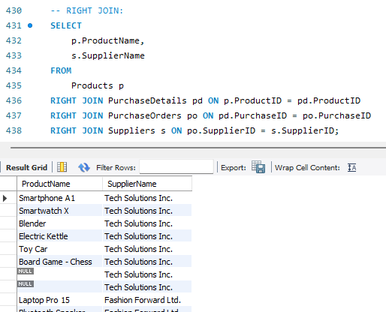
Joins
INNER JOIN
RIGHT JOIN
Observation: SQL query using an INNER JOIN to combine data from the Products and Product Categories tables, displaying the product ID, product name, and category name.
Observation: SQL query using RIGHT JOIN across four tables (Products, Purchase Details, Purchase Orders, and Suppliers) to retrieve product names and supplier names.

Slide 24
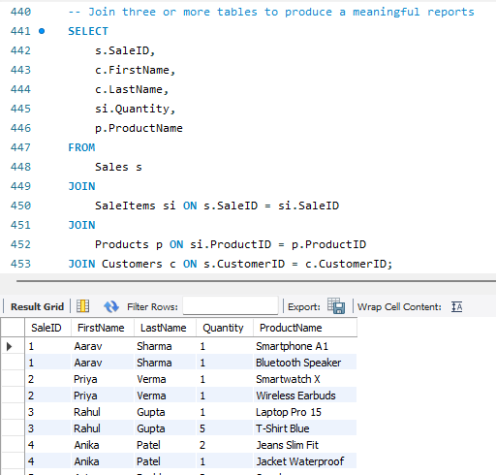
Joins
Observation: SQL query joining four tables (Sales, Sale Items, Products, and Customers) to retrieve sale details, including sale ID, customer name, quantity, and product name.

Slide 25
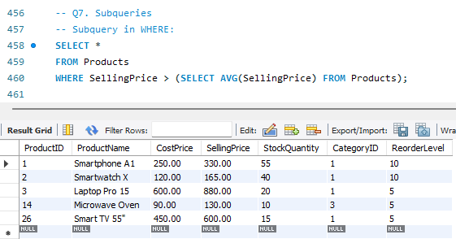
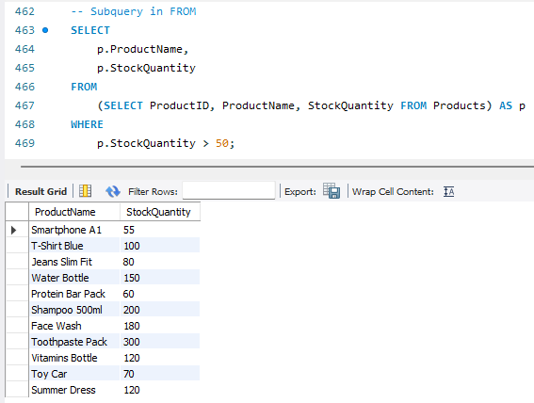
Subqueries
WHERE
FROM
Observation: SQL query that selects all columns from the Products table where the Selling Price is greater than the average selling price of all products.
Observation: SQL query using a subquery in the FROM clause to select product names and stock quantities for products with a stock quantity greater than 50.

Slide 26
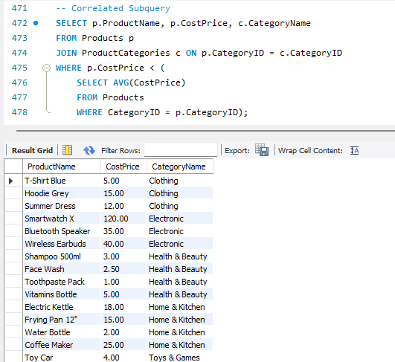
Subqueries
Correlated Subquery
Observation: SQL query that selects product names, cost prices, and category names for products with a cost price lower than the average cost price within their respective categories.

Slide 27
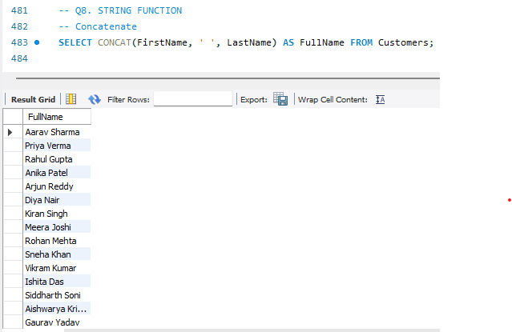
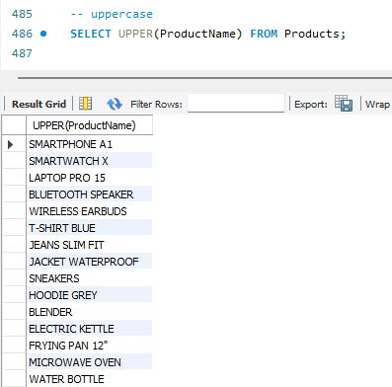
String Functions
Concatenate
Uppercase
Observation: SQL query using the CONCAT() function to combine the First Name and Last Name columns from the Customers table into a single Full Name column
Observation: SQL query using UPPER() function to convert all product names in the Products table to uppercase

Slide 28
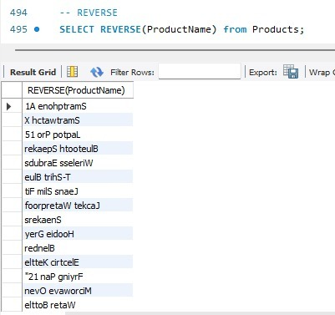
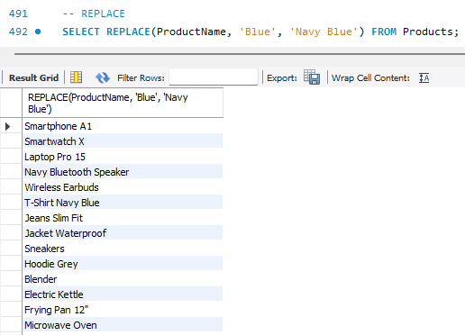
String Functions
Reverse
Replace
Observation: the result of a SQL query that uses the REVERSE() function to reverse the order of characters in the Product Name column from the Products table.
Observation: SQL query using the REPLACE() function to substitute "Blue" with "Navy Blue" in the Product Name column of the Products table.

Slide 29
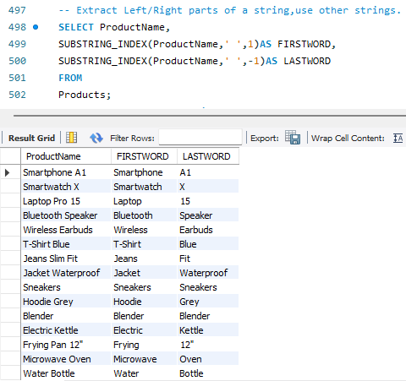

String Functions
Substring
Observation: SQL query using the SUBSTRING() function to extract the first 5 characters from the Product Name column in the Products table.
Observation:SQL query using SUBSTRING_INDEX() to extract the first and last words from the Product Name column in the Products table.

Slide 30


Date & Time Functions
Observation: SQL query that extracts the year, month, and day from the Sale Date column in the Sales table.
Observation: SQL query using the DATE_ADD function to add 7 days to Sale Date and its corresponding output in a result grid.

Slide 31


Date & Time Functions
Observation: SQL query using NOW(), CURDATE(), and CURTIME() to retrieve the current date and time, current date, and current time respectively.
Observation:SQL query using the DATEDIFF() function to calculate the difference in days between two order dates from the Purchase Orders table, specifically for Purchase IDs 1 and 2, with the result being 1 day.

Slide 32


Conditional Logic & CASE
Observation: SQL query using a CASE statement to categorize products based on their Stock Quantity into 'High Stock', 'Medium Stock', and 'Low Stock' categories.
Observation: SQL query using a CASE statement within the ORDER BY clause to conditionally sort products, either by Selling Price for Category ID 1 or by Product Name for other categories, along with the query's result

Slide 33


Views
Observation: SQL code for creating a view named Top Customers that selects customer data and calculates total sales for each customer, ordering the results by total sales in descending order.

Slide 34


Views
Observation: SQL code to create a view named Public Product List by selecting Product Name, Selling Price, Stock Quantity, and Category Name from the joined Products and Product Categories tables.

Slide 35
Conclusion
The Product Inventory & Billing System successfully demonstrates how structured database design and SQL functionalities can solve real-world business challenges.
Through effective data modeling, query development, and report generation, the system:-
Enhances inventory visibility and stock management
Streamlines billing and customer interactions
Improves supplier coordination and sales tracking
Empowers businesses with accurate, real-time data for decision-making

Slide 36

THANK YOU

